Slide 1

PowerChart Ambulatory ASP Immunizations Overview
Presenter’s name goes here
Presenter’s title goes here
920978183_PowerChart Ambulatory ASP Immunizations Overview_Rev2

Slide 2
Immunizations Overview
Agenda
Setting up your Immunization Inventory
Ordering an Immunization
Charting an Immunization
Transmitting Immunization Data to a Registry
Registry Import
Notes:
Setting up your Immunization Inventory
Will detail how to set up your immunization inventory using the Immunization Management Worklist—we suggest this is done prior to charting immunizations
Ordering an Immunization
Will review how to order immunizations
Charting an Immunization
Will detail how to complete all recommended documentation when charting an immunization including the responsible party detail form, consents and immunization administration form
Transmitting Immunization Data to a Registry
Will review real time and batch uploads
Registry Import
review how to incorporate

Slide 3

Setting up Your Immunization Inventory
Immunization Management Worklist
Notes:
SECTION SLIDE: Right-click image to replace.
**Slide not built in master slides due to the ability to swap out images.

Slide 4
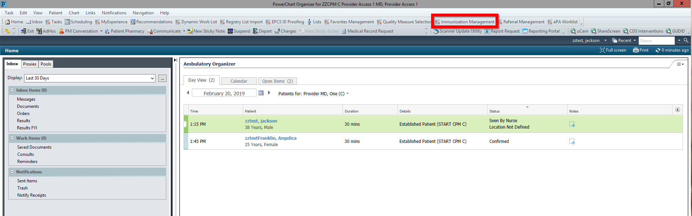
Setting up you Immunization Inventory
Immunization Management Worklist
The Immunization Management Worklist is a tool that allows users to create an Inventory of the immunizations administered at their clinics
Once an inventory is created, it will be searchable when immunizations are administered assisting with populating accurate NDC numbers and helping manage the immunization inventory at your clinic
Access the Immunization Management Worklist from the toolbar

Slide 5
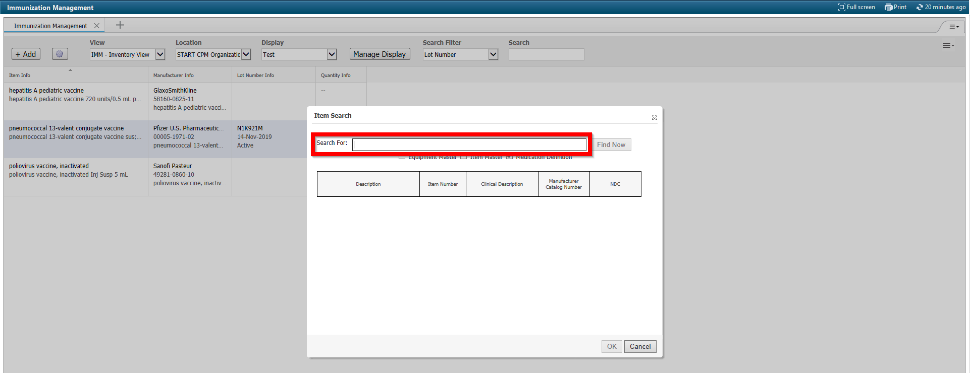
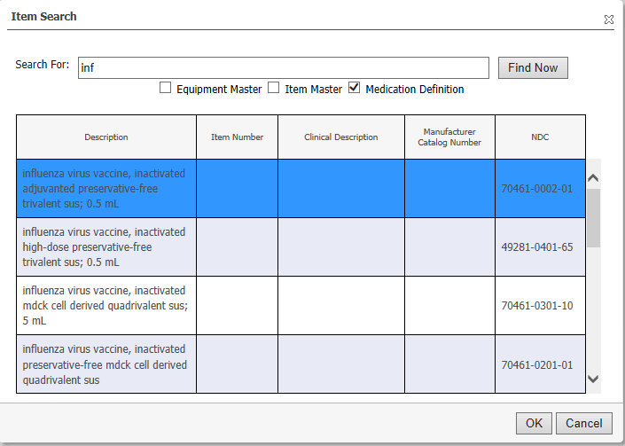
Setting Up your Immunization Inventory
Creating your Worklist
Select the Location for the Clinic worklist you are building from the location dropdown. If desired, you can create different displays with the Manage Display button per location (current immunizations, expired immunizations, etc.)
Click the Add button to start building your inventory
In the Item Search window, search for the immunization you want to add either by NDC or Product Description and click OK. Next select the Product you would like to add to your list and click OK.

Slide 6
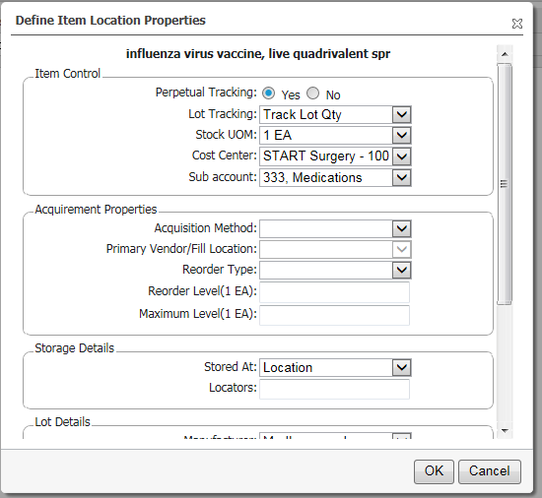
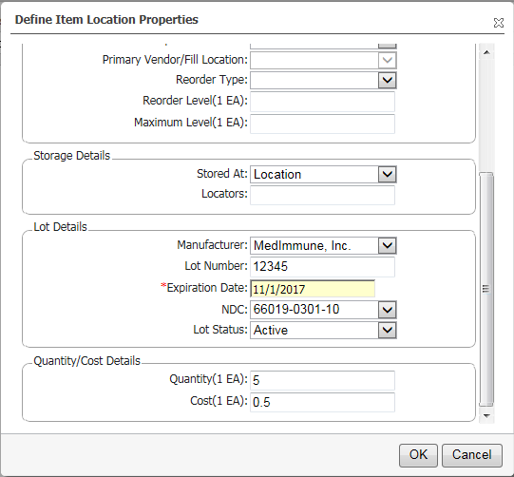
Setting Up your Immunization Inventory
Creating your Worklist continued
4. Complete the Define Item Location Properties window
If the item is not defined for the location, the system will return the display only and required configuration for the location within the template.
Enter the required information in the window and fill out Item Control, Storage Details, Lot Details and Quantity/Cost Details. Click OK
Access this link for more information on the Immunization Management Worklist

Slide 7
Ordering an Immunization

Slide 8
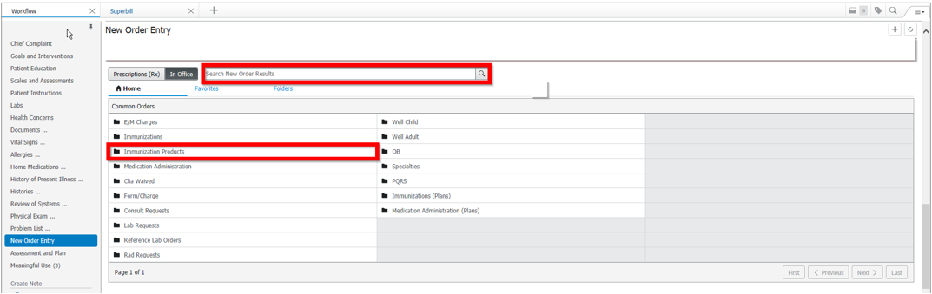
Ordering an Immunization
Navigate to the New Order Entry component on the Workflow page and select In Office
Search for the Immunization by Brand Name or click on the Immunizations Products folder to see a list of common immunizations
Note: Each drug has it’s own code behind the scenes. Selecting the drug name rather than the immunization name like ‘Influenza’ ensures that your state registry gets an accurate account of what was given to the patient and ensures that your office inventory is tracked properly.
Notes:
"You should always search for the exact name of the drug in the immunization you're administering when applicable (e.g. "Tenivac", not "Tetanus"). The default list in the Immunizations folder will pick the generic immunization in most cases, which may differ from what you have in your inventory. Selecting the generic version can cause coding and inventory tracking problems at the registry. Furthermore, if you are presented with two options - for example, "Drug Name" and "Drug Name (0.5mL, im, once)", you should select the more detailed option provided that it matches your inventory exactly. In this case, "close" is not close enough - if you're administering a 1.0mL dose, you should select the "Drug Name" option, not the "...(0.5mL, im, once)" option. Also keep in mind that different searches give different results - "Hep B" is not the same as "Hepatitis B“ for instance.

Slide 9
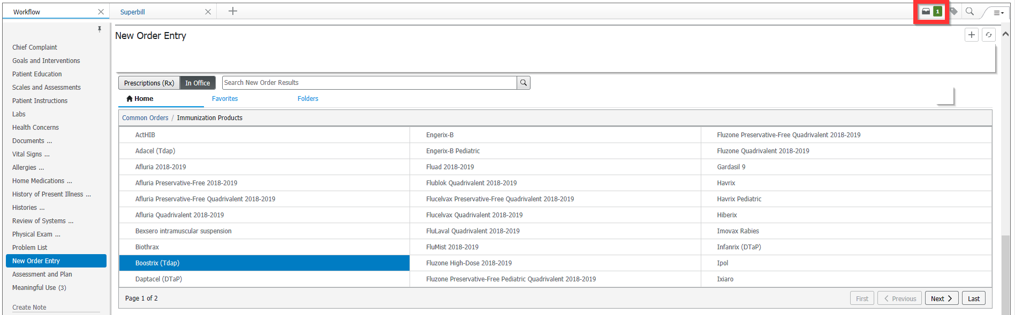
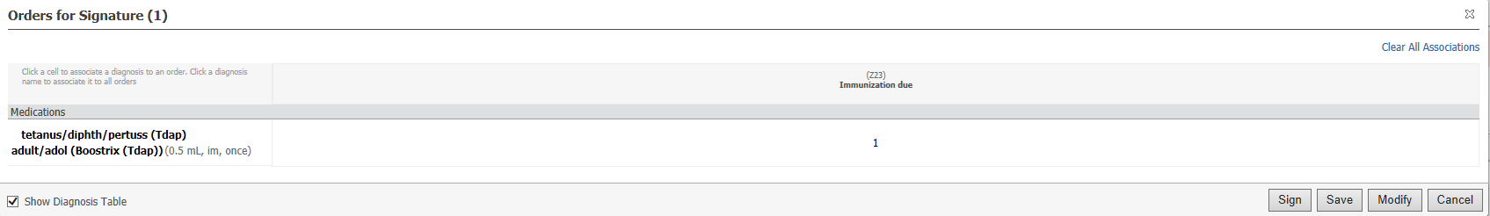
Ordering an Immunization
3. Select the immunization and launch the orders dialogue box in the right hand corner to sign the order and associate a diagnosis.
4. Associate the appropriate diagnosis to the order (if no diagnosis added, you can add in the order details window) and click sign. If any modifications need to be made to the order, click modify to launch the order details window.

Slide 10
Charting an Immunization

Slide 11
Charting an Immunization
Prerequisite Documentation
Complete the following documentation prior to charting the immunization in the Immunization Administration Form
Responsible Party Detail Form
The responsible party is the person who is legally responsible for and makes decisions for the patient. The responsible party in this context is distinct and separate from the financially responsible party (or guarantor), which is collected as billing information. In children, the responsible party is a consenting adult who permits for the administration of the immunization and who permits the information to be sent to the state.
The AIRA (American Immunization Registry Association) and the CDC agree that information on the Responsible Party is an important element for data quality assurance. This information is especially important in the longitudinal tracking of children receiving immunizations.
Consents Form
Notes:
This documentation is required in order to successfully send the immunization details over to the Immunization Registry. If this is not completed prior to completing the medication administration form, the immunization will not send to the registry and you will receive an error message.
The Responsible Party Detail form also acts as the Consent of the responsible party for the immunization to be sent to the registry. If the responsible party does NOT consent for their immunizations to be sent to the registry, do not fill out the form and this will stop the immunization from going through the interface. The Responsible Party Detail Form MUST be completed before the immunization is charted, this includes when entering historical data or when abstracting.

Slide 12
Prerequisite Documentation
Responsible Party Detail Form
Responsible Party is documented via the Responsible Party Detail AdHoc FormAt least 3 pieces of information must be documented to satisfy this requirement
Relationship to patient
First Name
Last Name
Note: Birthdate is required by some state registries
All other information on the form is not required, but is highly recommended
Once the form is completed, it will be saved to the chart for future encounters (only needs to be done once per patient)
Must be completed PRIOR to entering any immunizations for each patient. If not, the immunization must be uncharted and the workflow rekeyed in the correct order.

Slide 13
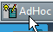
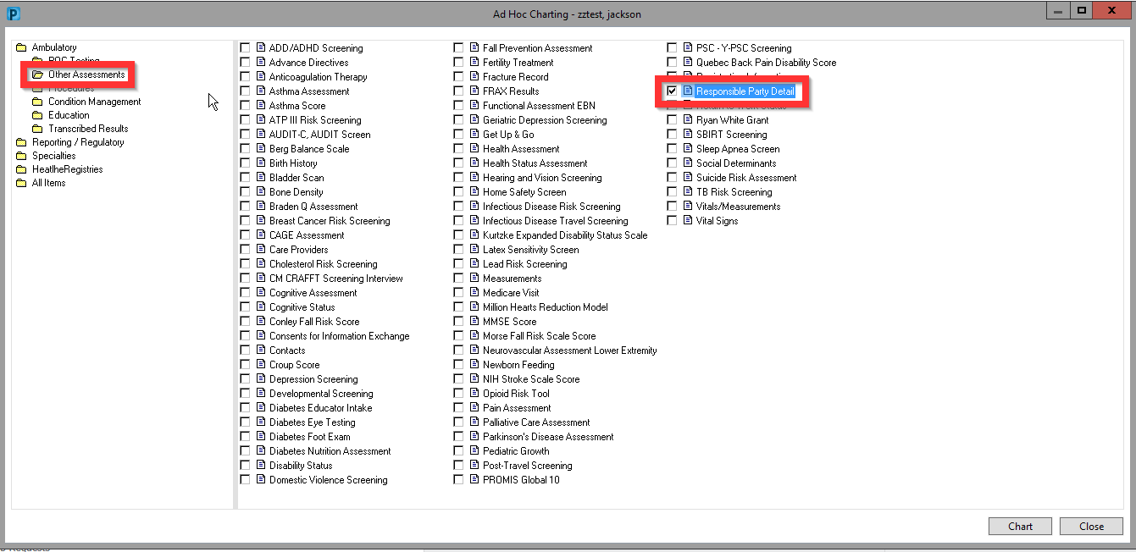
Responsible Party Detail Form
Accessing the Responsible Party Detail Form
The Responsible Party Detail Form is located in AdHoc within the patient’s chart. To access this, click the AdHoc button on your menu bar.
Open the Other Assessments folder and select the Responsible Party Detail form. Click Chart.

Slide 14
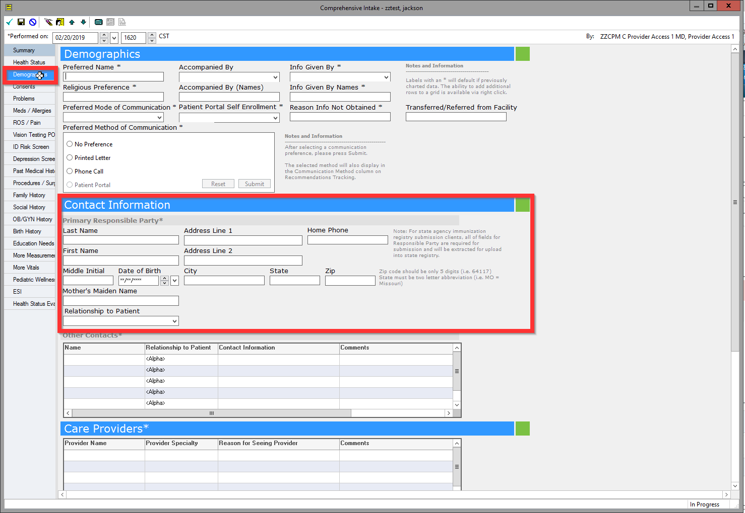
Responsible Party Detail Form
Accessing the Responsible Party Detail Form
Responsible Party information can also be found on both the Quick Intake and Comprehensive Intake forms as shown here. Click on the Demographics section and navigate to the Contact Information banner.

Slide 15
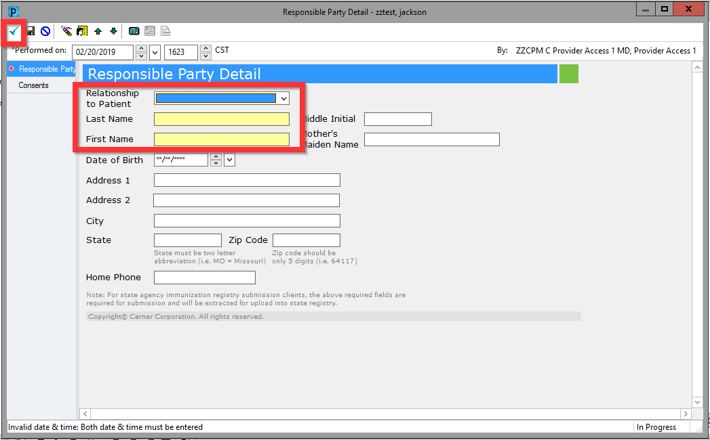
Responsible Party Detail Form
Completing the Responsible Party Detail Form
Complete the required fields (indicated in yellow) and click the green checkmark to sign the form into the chart.
Note: Although it is not highlighted in yellow, the Date of Birth field is also required by some state registries. The rest of the fields are not required but are still strongly recommended.

Slide 16
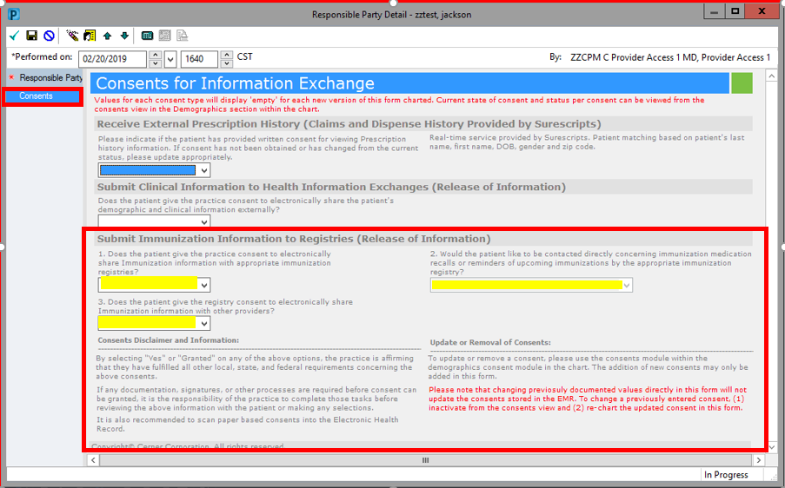
Prerequisite Documentation
Consent Form
The consent form is a subsection of the Responsible Party Detail Form as well as the Comprehensive and Quick Intake Forms
Note: If the value of the first drop-down is ‘Consent Denied,’ no messages will be sent to the immunization registry for that patient, and the user will not receive a notification of the unsent message.

Slide 17
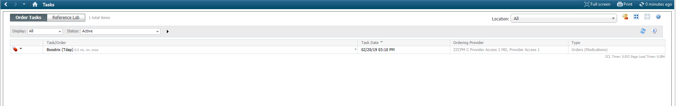
Charting an Immunization
Completing the Medication Administration Form
Once an order has been placed for an immunization, a task will appear on the patient’s task list
Navigate to the Task List and select the immunization you administered
The Medication Administration form where you will document the details of the immunization will open
Complete the Medication Administration Form

Slide 18
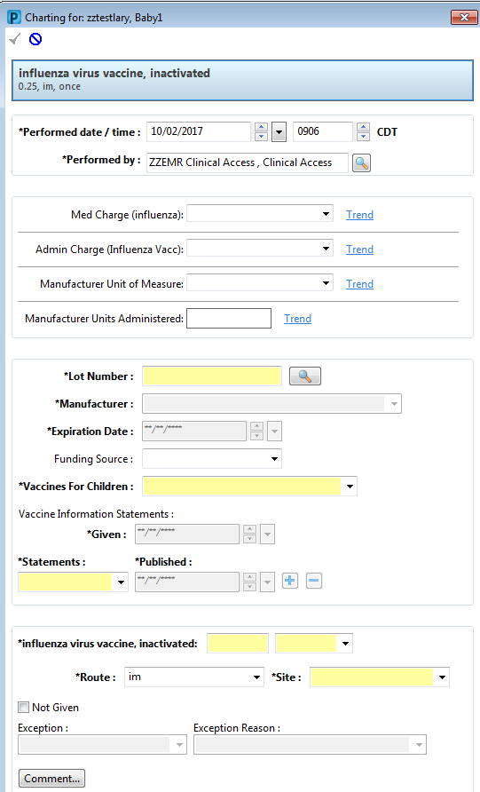
Charting an Immunization
Completing the Medication Administration Form
Complete all yellow required field
VFC needs to be completed when available
Med Charge, Admin Charge, Manufacturer Unit of Measure, Manufacturer Units Administered must be completed if you use CPM and recommended to be completed for all clients
Notes:
Not completing above fields can result in immunizations not sending to the Immunization Registry
Additionally, if med charge and admin charge are not completed, the charges will not drop for this immunization—if do not want clinical staff determining med charge and admin charge then provider can order by CPT code (charge) and order brand name immunization—clinical staff will just choose no charge in the med charge and admin charge field if this is the desired workflow
For historical immunizations, navigate to the immunizations section and select history and fill in details—responsible party detail form and consents must be filled our prior to this workflow also

Slide 19
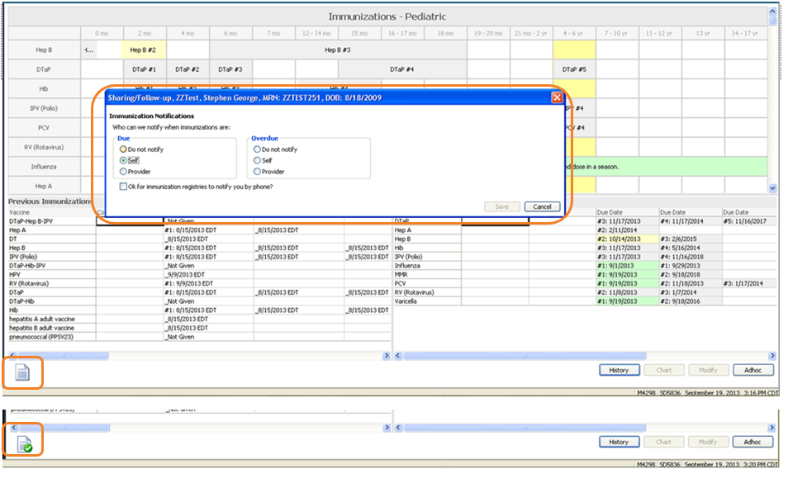
Charting an Immunization
Immunization Notifications
Notes:
On the Immunizations Tab, click the small sheet of paper and it opens these options. This informs the registry if you would like them to contact either the patient (self) or the provider when an immunization is due and overdue. You can also select do not notify. Once you fill out and save this information the sheet of paper will have a green checkmark to show it was completed. This is not a requirement.

Slide 20
Immunization Registries

Slide 21
Immunization Registries
Real Time Reporting States
Immunizations upload directly to the Registry after documentation is completed.
Responsible Party Detail form must be filled out prior to documenting the immunizations otherwise it will not send to Registry
Any patient that does not have the documentation completed correctly will result in an error message being send to email address provided for each immunization charted per patient
Notes:
Your immunization will directly upload to the state after completing the Responsible Party Detail form and documenting the immunization through the workflow provided in the previous slides. No additional work is needed.
As previously shown, if the Responsible Party Detail form is not completed on ALL patients PRIOR to any immunization documented (including historical immunizations), an error message will be sent to the email address you provided for each immunization charted per patient.

Slide 22
Immunization Registries
Batch Reporting States
Step 1
A Cerner Associate will submit a request to Cerner Enterprise Security to create an individual account for any user you choose. This user will be able to access the batch immunization files to upload to your state’s registry website.
Create a folder on your computer's desktop to temporarily house the sFTP file before uploading it to your state’s immunization registry.
How to create the folder:
Using your mouse, right click on your desktop. A menu of options appear.
Scroll down to “New” and an additional menu of options will appear.
Select “Folder.”
Name the folder (for example, Immunization Downloads)

Slide 23
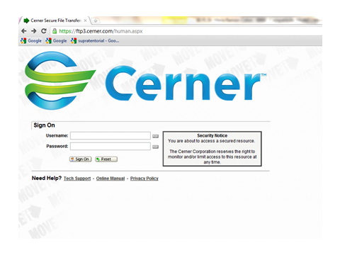
Immunization Registries
Batch Reporting States
Step 2
Log onto https://ftp3.cerner.com using Internet Explorer
Step 3
Use the username and password given to you by Cerner Enterprise Security
When you initially log on, you will be given the opportunity to change the password to one that is personal to you. Please choose a secure password (one that uses upper case letters, lower case letters and numbers.

Slide 24
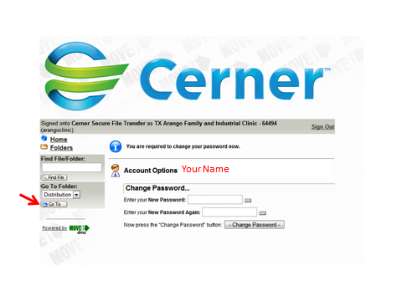
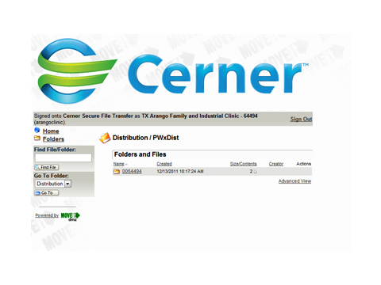
Immunization Registries
Batch Reporting States
Step 4
Once your password has been reset, click on the “Go To” button located on the left side of the screen which will launch a new page
Step 5
Your Secure File documents are located in this folder. Click on the folder to open it

Slide 25
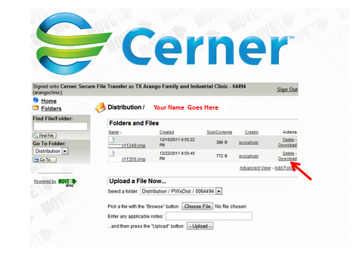
Immunization Registries
Batch Reporting States
Step 6
Find the most recent File and click "Download".
**Notice that you also have a "delete" option as well. You will want to delete any file that is more than a week old. This will keep your files organized and you won't have an excess of older files in your SFTP folder.***

Slide 26
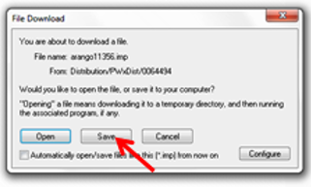
Immunization Registries
Batch Reporting States
Step 7
A dialogue box will pop up. Click "Save" and save this document to the immunization download file you created on your desktop. Now the file is ready to be securely transferred to the immunization registry.
Step 8
Log onto the immunization registry's secure file location. *Your state registry will provide this info to you.*
Upload the immunization download file on your desktop to the immunization registry's SFTP folder or website.
Step 9
Delete the immunization download file that was housed temporarily on your desktop.

Slide 27
Registry Import
Notes:
You can import immunizations from your state registry if the bidirectional connection has been enabled

Slide 28
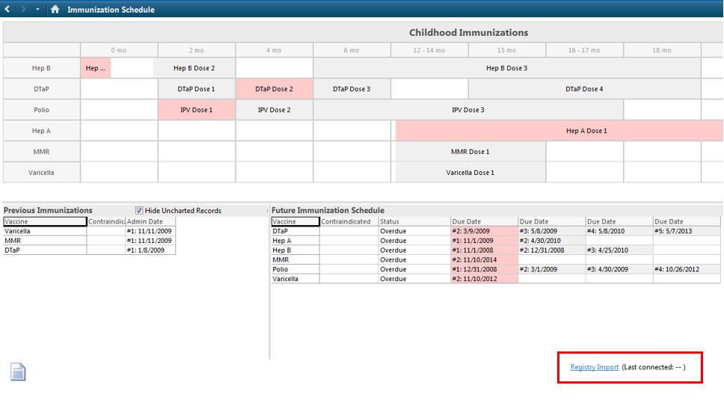
Registry Import
Importing Immunizations
Navigate to the Immunization section of the patient’s chart
Click the blue Registry Import hyperlink in the bottom right of the screen

Slide 29
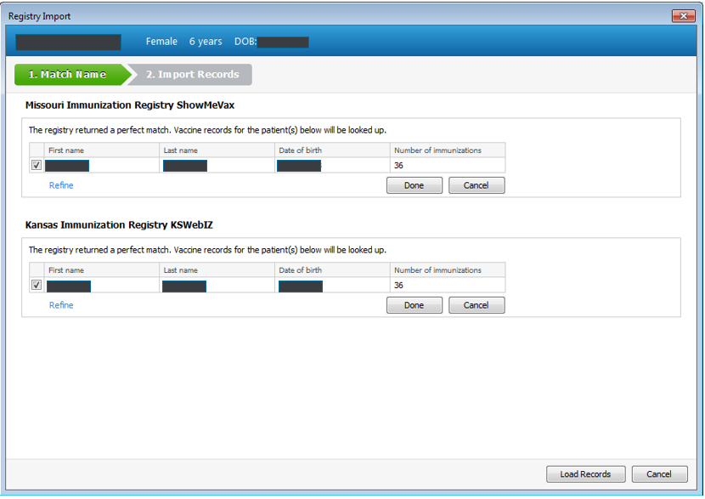
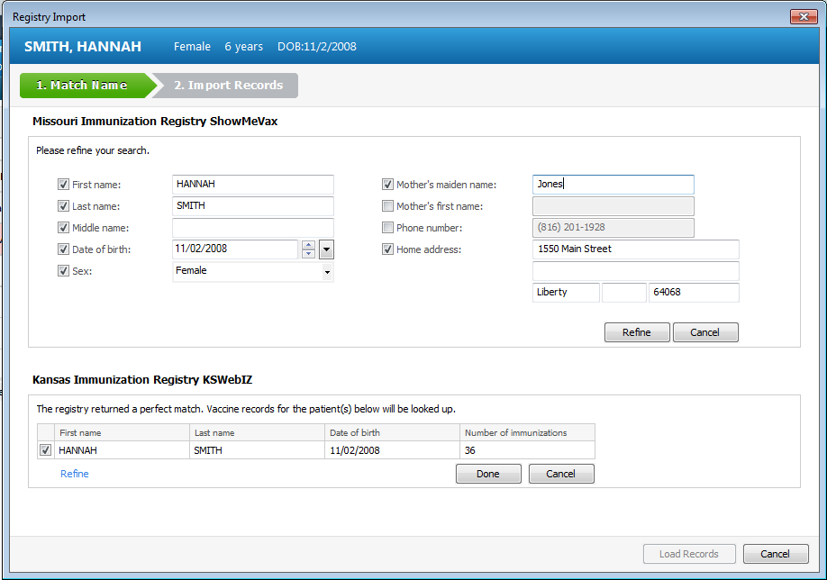
Registry Import
Importing Immunizations
Verify which registries you want to load records from by checking off the box next to the name of the patient and clicking done
Click Load Records
If needed refine your search by clicking the Refine hyperlink

Slide 30
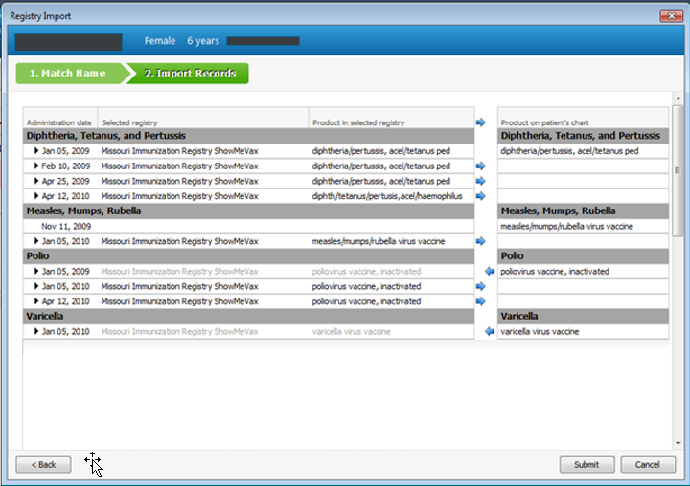
Registry Import
Importing Immunizations
Click the blue arrows to bring the immunizations from the registry to the patient’s chart
Once all the immunizations you want to add are in the Product on patient’s chart column click submit

Slide 31
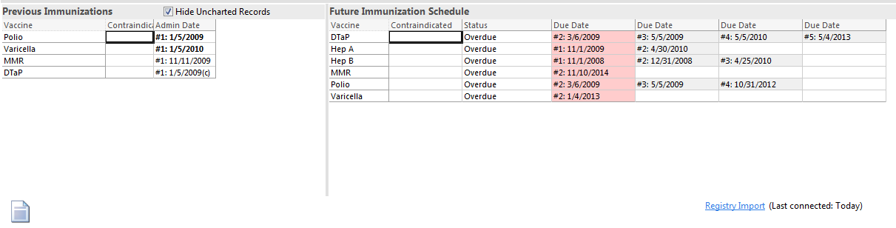
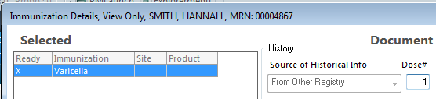
Registry Import
Importing Immunizations
You can view the imported immunizations in the previous immunizations list
Imported doses will appear bold until refresh
If documented as given within the appropriate age range, the system will satisfy the need for that vaccine and adjust the future schedule
User can view this information came from the registry by opening the details of the dose

Slide 32
Please contact Support at 800-277-7330 anytime from 6 am – 6 pm CST if you have any questions!

